Slide 1


Name: Yashar Janparvar Javdani
Date:16-January-2023

Slide 2

Outline
Executive Summary
Introduction
Methodology
Results
Conclusion
Appendix

Slide 3
Executive Summary
Summary of methodologies
Data Collection Rest API
Data Collection
Data Wrangling
Exploratory Data Analysis with SQL
Exploratory Data Analysis with Data Visualization
Interactive Data Visualization with Folium and Ploty Dash
Machine Learning Prediction
Summary of all results
Collect Data and Analysis result
Drawing analytical charts
Use Machine Learning algorithm and predict result

Slide 4
Introduction
Project background and context
SpaceX advertises Falcon 9 rocket launches on its website with a cost of 62 million dollars; other providers cost upwards of 165 million dollars each, much of the savings is because. SpaceX can reuse the first stage. Therefore, if we can determine if the first stage will land, we can determine the cost of a launch
Problems you want to find answers
The interaction amongst various features that determine the success rate of a successful landing.
For a given set of features about a Falcon 9 rocket launch, will the first stage of the rocket land successfully?

Slide 5

Section 1

Slide 6
Methodology
Executive Summary
Data collection methodology:
SpaceX REST API and web scraping List of SpaceX Falcon 9 launches wiki article
Perform data wrangling
Assigning appropriate data types and dealing with NaN values appropriately
Perform exploratory data analysis (EDA) using visualization and SQL
Perform interactive visual analytics using Folium and Plotly Dash
Perform predictive analysis using classification models
Built several classification models and evaluated the accuracy of each to determine the best model

Slide 7
Data Collection
First get data from url with this method requests.get(spacex_url)
Convert raw data to json data with this method json_data=response.json()
After that normalized json data and converted to data frame data=pd.json_normalize(json_data)
Extract Useful Columns and create dict
Create data from a dict with this method dataDict=pd.DataFrame(launch_dict)
Filter dataframe to only include Falcon 9 launches
Calculate the mean value of PayloadMass column with this method x=data_falcon9['PayloadMass'].mean()
Handle missing values with this method data_falcon9['PayloadMass'].replace(np.nan,x, inplace=True)
Export to CSV file

Slide 8
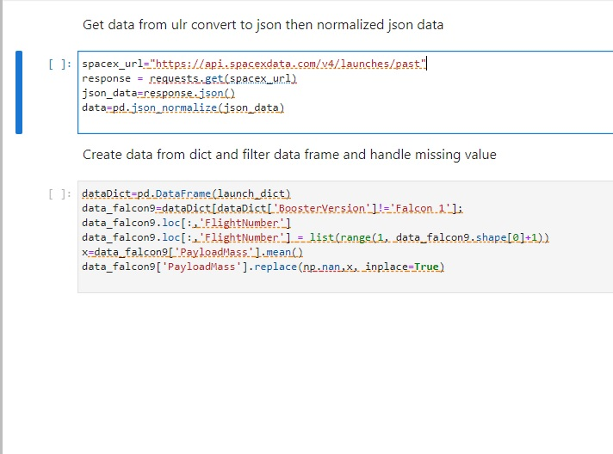
Data Collection – SpaceX API
Get Request to SpaceX API
Convert Response to Json Data
Convert Json to Data Frame
Export CSV
Filter and Clean up Data
GitHub URL: Collecting the data

Slide 9
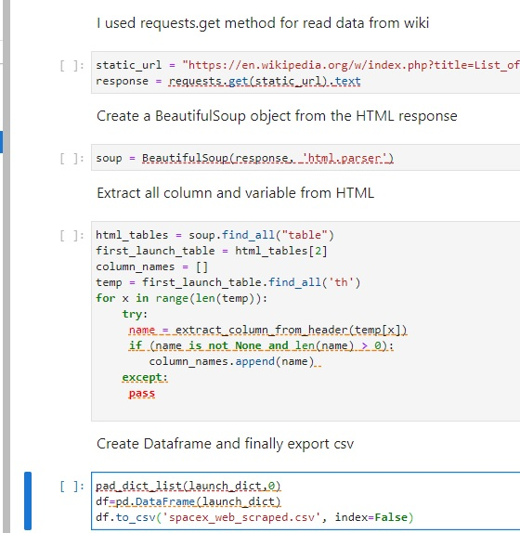
Data Collection - Scraping
Get Request to SpaceX API
Use BeautifulSoup to convert data
Extract Table element from HTML tags
Filter and clean up data and export CSV
Store the data in a pandas dataframe
GitHub URL: Data Collection -Scraping

Slide 10
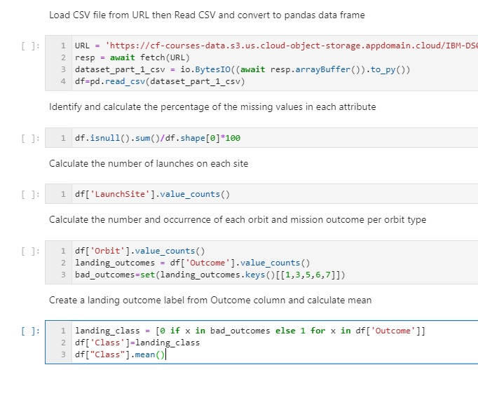
Data Wrangling
Load CSV and convert to pandas data frame
Calculate missing value in each attribute
Calculate number of launches on each site
Create class feature base on mission outcome column
Calculate number of each mission outcome per orbit type
GitHub URL: Data wrangling

Slide 11
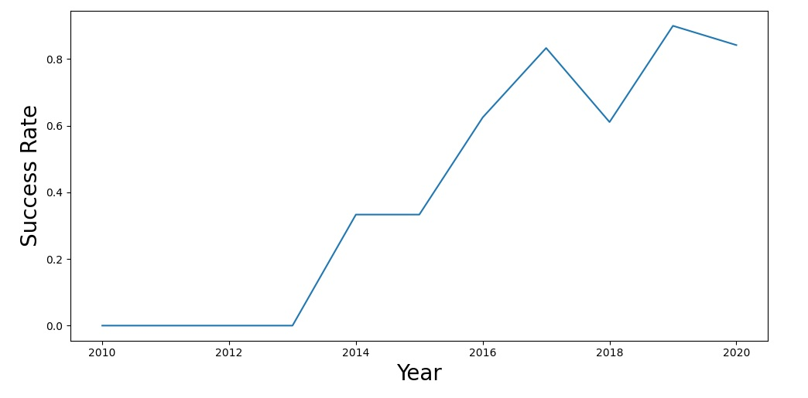
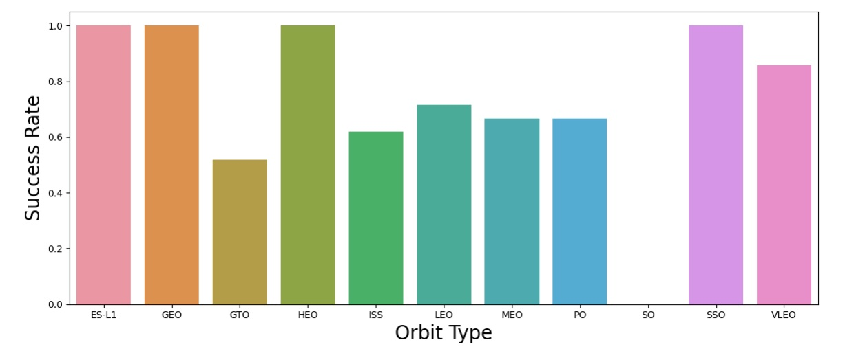
EDA with Data Visualization
Scatter plots: Scatter plots were used to represent the relationship between two variables. Different sets of features were compared such as Flight Number vs. Launch Site, Payload vs. Launch Site, Flight Number vs. Orbit Type and Payload vs. Orbit Type.
Landing success rate versus Orbit type – to see if orbit type influenced the landing success rate
Bar chart: Bar charts were used makes it easy to compare values between multiple groups at a glance. The x-axis represents a category and the y-axis represents a discrete value. Bar charts were used to compare the Success Rate for different Orbit Types
GitHub URL: Exploring and Preparing Data

Slide 12
EDA with SQL
SELECT distinct(LAUNCH_SITE) from SPACEXTBL
Display unique launch site in the space mission
SELECT * from SPACEXTBL WHERE LAUNCH_SITE LIKE 'CCA%' LIMIT 5
Display 5 records where launch sites begin with the string 'CCA'
SELECT SUM(PAYLOAD_MASS__KG_) from SPACEXTBL WHERE CUSTOMER = 'NASA (CRS)'
Display the total payload mass carried by boosters launched by NASA (CRS)
SELECT DATE, "Landing _Outcome", BOOSTER_VERSION, LAUNCH_SITE from SPACEXTBL WHERE "Landing _Outcome" = 'Failure (drone ship)' AND substr(Date,7,4) LIKE '%2015'
List the records which will display the month names, failure landing_outcomes in drone ship ,booster versions, launch_site for the months in year 2015(use substr because of sqllite)
GitHub URL: EDA SQL

Slide 13
Build an Interactive Map with Folium
We marked all launch sites, and added map objects such as markers, circles, lines to mark the success or failure of launches for each site on the folium map.
Red and green marker clusters were added to indicate successful and failed landings at each launch site
Line markers were added to indicate distance of launch site from coastline, nearest city, highway, and railway
We calculated the distances between a launch site to its proximities. We answered some question for instance:
Are launch sites near railways, highways and coastlines.
Do launch sites keep certain distance away from cities.
GitHub URL: Launch Sites Locations Analysis with Folium

Slide 14
Build a Dashboard with Plotly Dash
Pie chart showing success rate at the user chosen site. If all sites were picked, then the percentage of total successes at each site is shown as a pie chart – to quickly visualize success rates at each site
The dashboard takes two inputs, namely the site(s) and payload mass. User input payload mass range slider – user can change the range of payload mass for which they can see the plot of success class versus payload mass graph (for the user chosen launch site), color coded by booster version – to see if class can be separated at a critical payload mass
GitHub URL: Ploty Dash

Slide 15
Predictive Analysis (Classification)
All above steps is repeated for all classification model.
We built different machine learning models and tune different hyperparameters using GridSearchCV
We used This Classification Model: Logistic Regression, Support Vector Machine, Decision Tree, K Nearest Neighbours
We used accuracy as the metric for our model, improved the model using feature engineering and algorithm tuning.
GitHub URL: Machine Learning Prediction
Loaded Data From numpy and pandas
Transformed Data.Data separated into features and labels
Train-Test-Split
Model Training with training data
Model Score and confusion matrix and evaluated test set

Slide 16
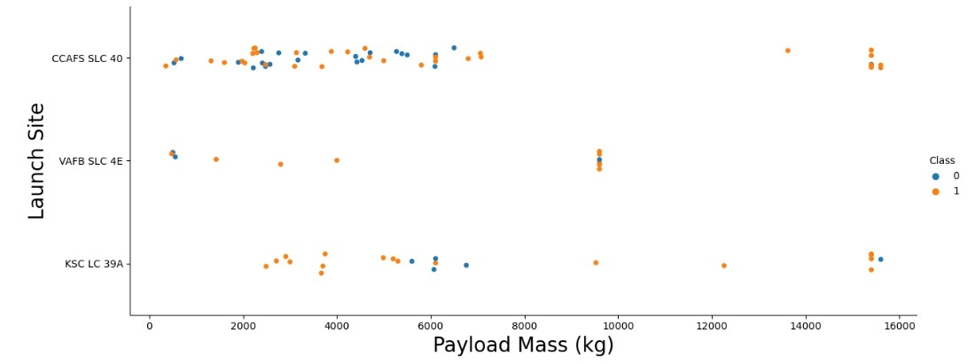
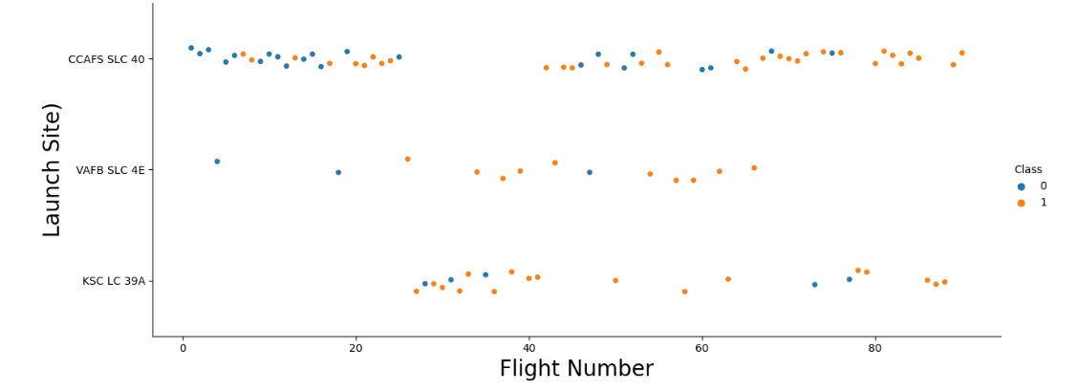
Results EDA

Slide 17
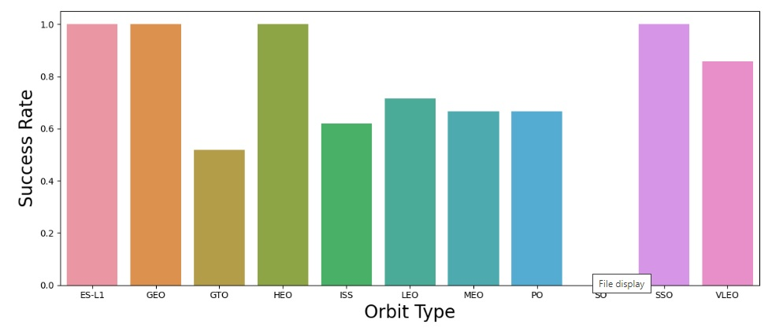
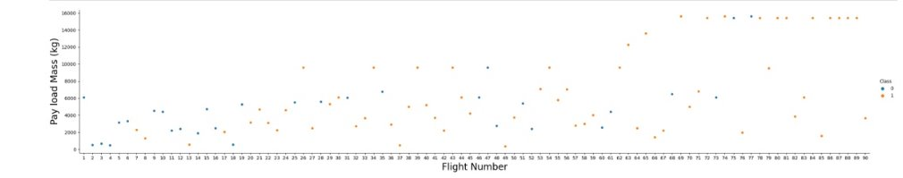
Results EDA

Slide 18
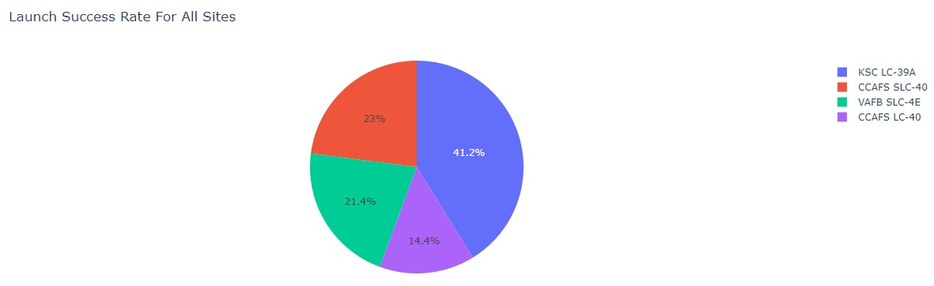
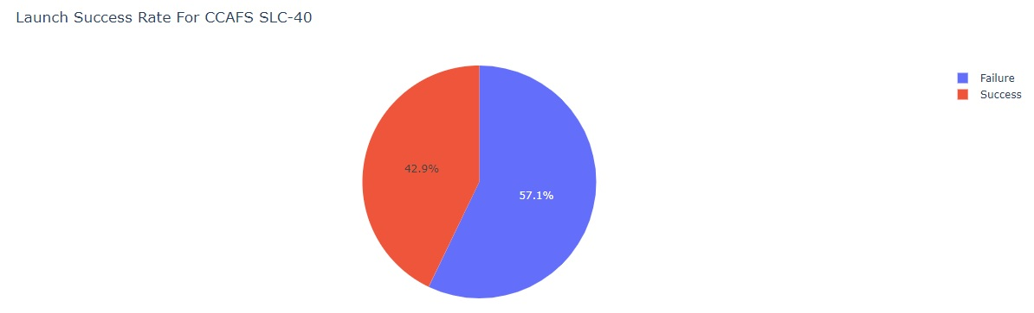
Results Dashboard

Slide 19
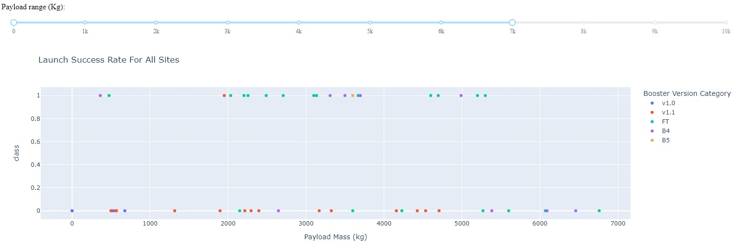
Results Dashboard

Slide 20
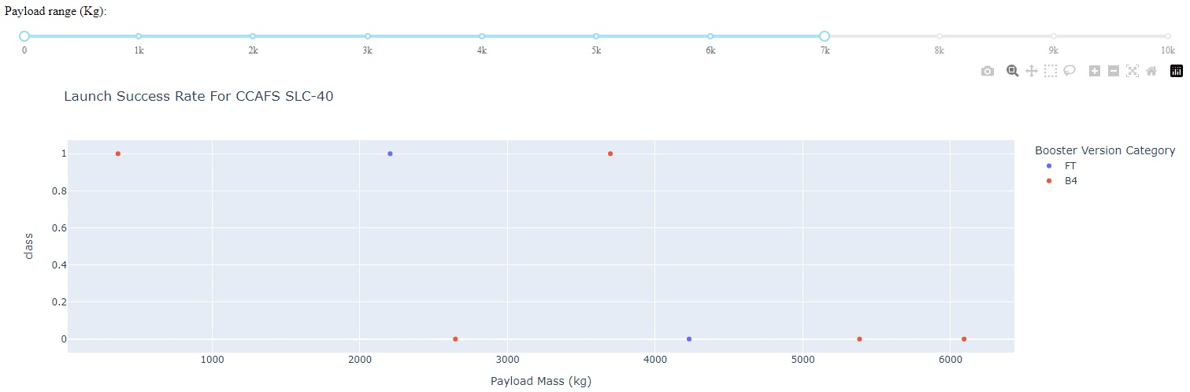
Results Dashboard

Slide 21
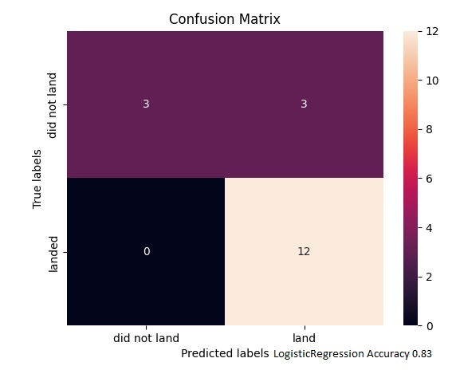
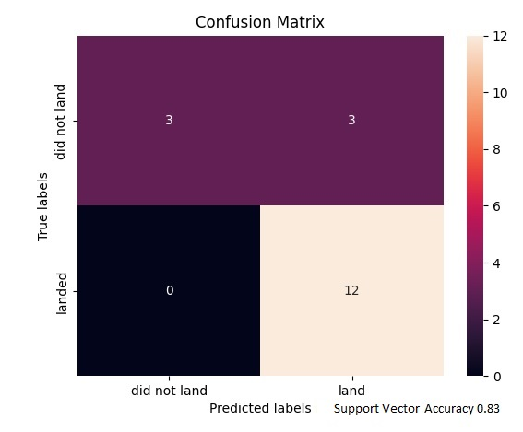
Results Predictive Analysis

Slide 22

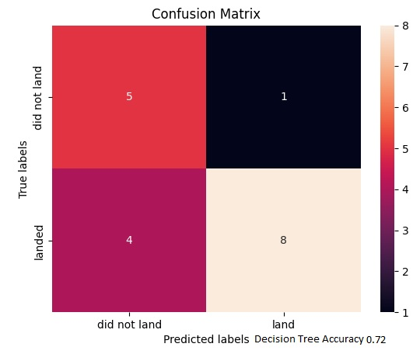
Results Predictive Analysis

Slide 23

Section 2

Slide 24
Flight Number vs. Launch Site
CCAFS SLC-40 site was not used for flight numbers between 25 and 40 – KSC LC 39A was used for those numbers instead
This figure shows that the success rate increased as the number of flights increased.
VAFB SLC 4E is the least used launch site whereas CCAFS SLC 40 is the most used launch site
There seems to be an increase in successful flights after the 40th launch.

Slide 25
Payload vs. Launch Site
At VAFB SLC 4E the payload mass is always less than 10k
The blue dots represent the successful launches while the red dots represent unsuccessful launches.

Slide 26
Success Rate vs. Orbit Type
From the plot, we can see that ES L1, GEO, HEO, SSO, VLEO had the most success rate.
SO orbit did not have any successful launches with a 0% success rate.

Slide 27
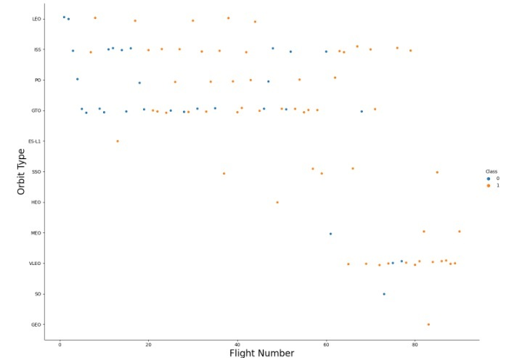
Flight Number vs. Orbit Type
In the LEO orbit, the success is positively correlated to the number of flights.
The SSO orbit has a 100% success rate however with fewer flights than the other orbits
ISS and GTO are more popular than the rest

Slide 28
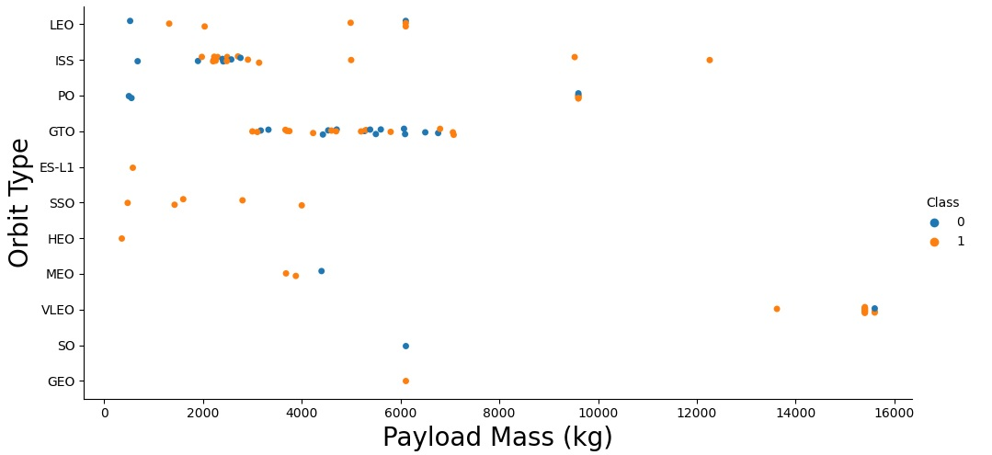
Payload vs. Orbit Type
For PO and LEO, landing fails at low payload mass while it is successful at higher payload mass
For VLEO the payload is the heaviest
For LEO, SSO, HEO, ES-L1 the payload is light

Slide 29
Launch Success Yearly Trend
The average success rate increases over the years from 2013

Slide 30
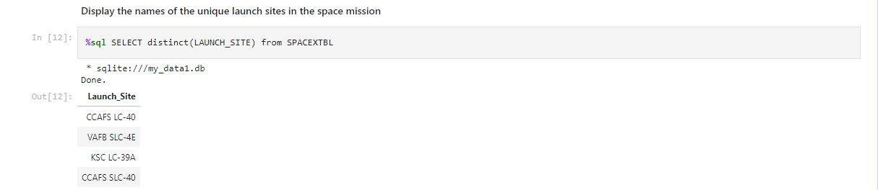
All Launch Site Names
We used the key word DISTINCT to show only unique launch sites from the SpaceX data.

Slide 31
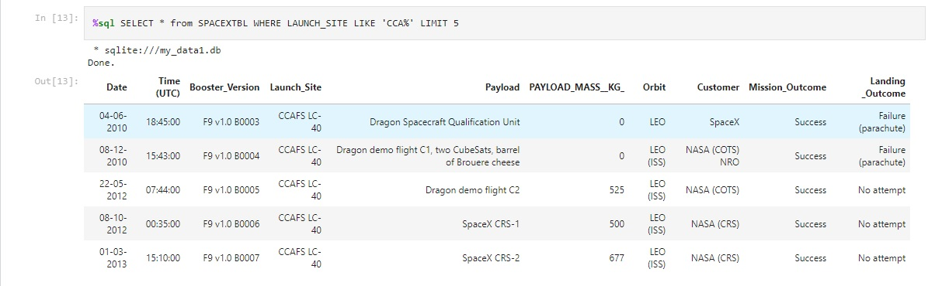
Launch Site Names Begin with 'CCA'
We used the query above to display 5 records where launch sites begin with CCA

Slide 32
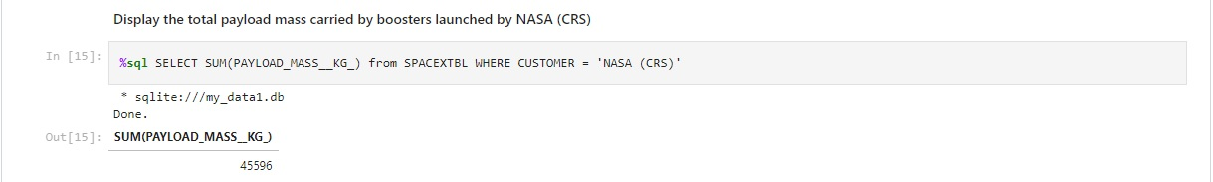
Total Payload Mass
We calculated the total payload carried by boosters from NASA as 45596 using the query below

Slide 33
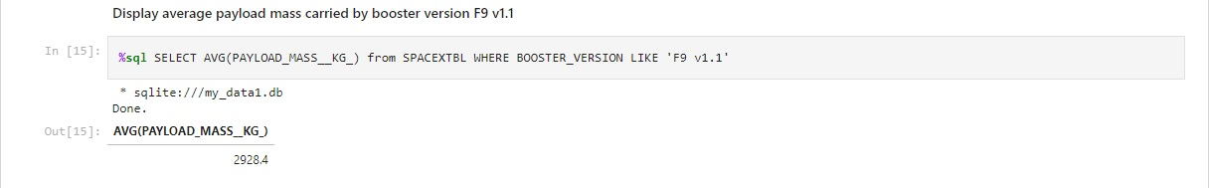
Average Payload Mass by F9 v1.1
We calculated the average payload mass carried by booster version F9 v1.1 as 2928.4

Slide 34
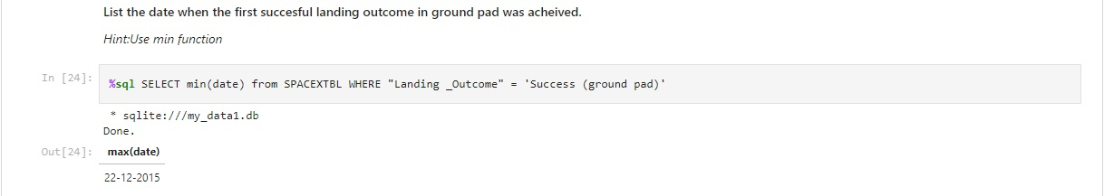
First Successful Ground Landing Date
We observed that the dates of the first successful landing outcome on ground pad was 22 December 2015

Slide 35
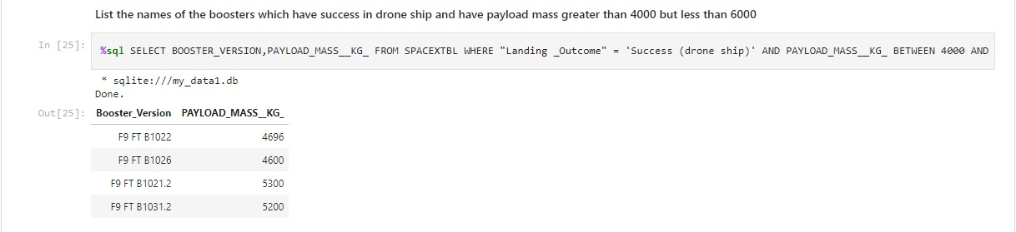
Successful Drone Ship Landing with Payload between 4000 and 6000
We used the WHERE clause to filter for boosters which have successfully landed on drone ship and applied the AND condition to determine successful landing with payload mass greater than 4000 but less than 6000

Slide 36
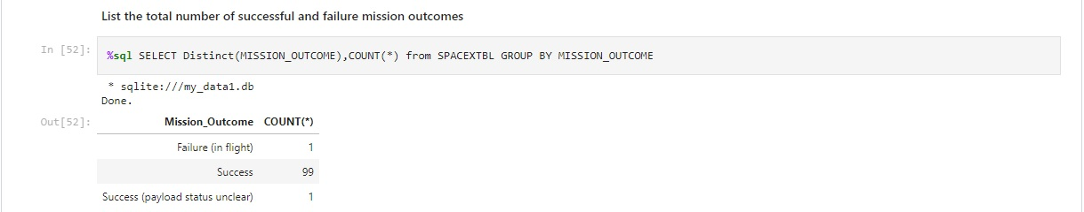
Total Number of Successful and Failure Mission Outcomes
The COUNT() function is used to count the number of occurences of different mission outcomes with the help of the GROUPBY clause applied to the 'mission_outcome' column. A list of the total number of successful and failure mission outcomes os returned.

Slide 37
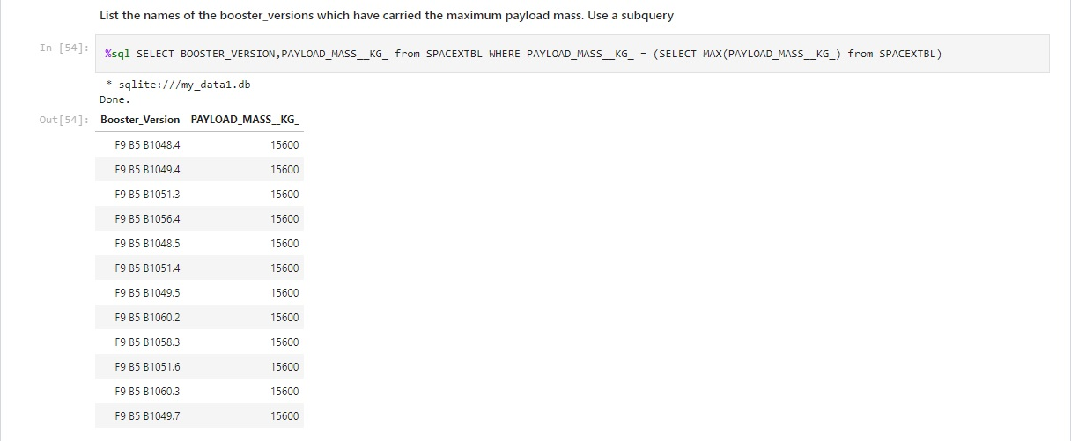
Boosters Carried Maximum Payload
We determined the booster that have carried the maximum payload using a subquery in the WHERE clause and the MAX() function.

Slide 38
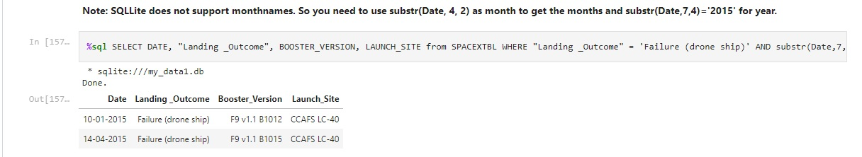
2015 Launch Records
We used a combinations of the WHERE clause, LIKE , AND , and BETWEEN conditions to filter for failed landing outcomes in drone ship, their booster versions, and launch site names for year 2015

Slide 39
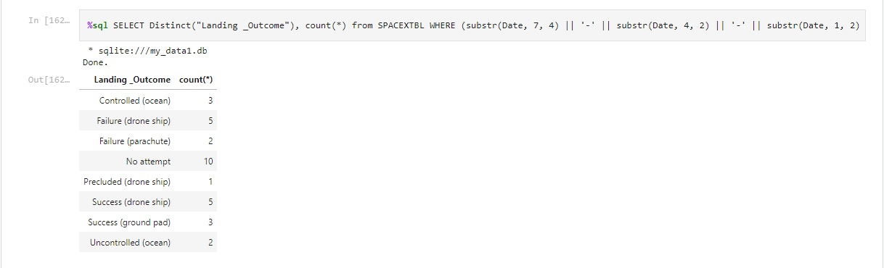
Rank Landing Outcomes Between 2010-06-04 and 2017-03-20
We selected Landing outcomes and the COUNT of landing outcomes from the data and used the WHERE clause to filter for landing outcomes BETWEEN 2010 06 04 to 2010 03 20.

Slide 40

Section 3

Slide 41
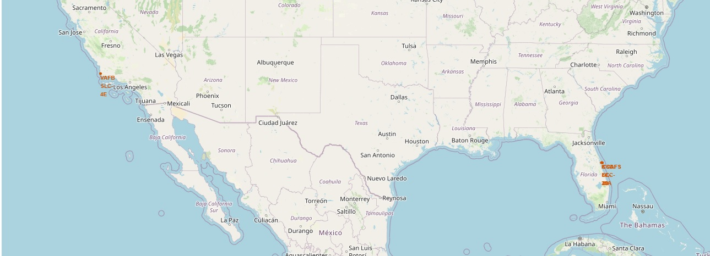
Falcon 9 launch Sites
The launch sites are marked with a red circle and labelled in red font

Slide 42
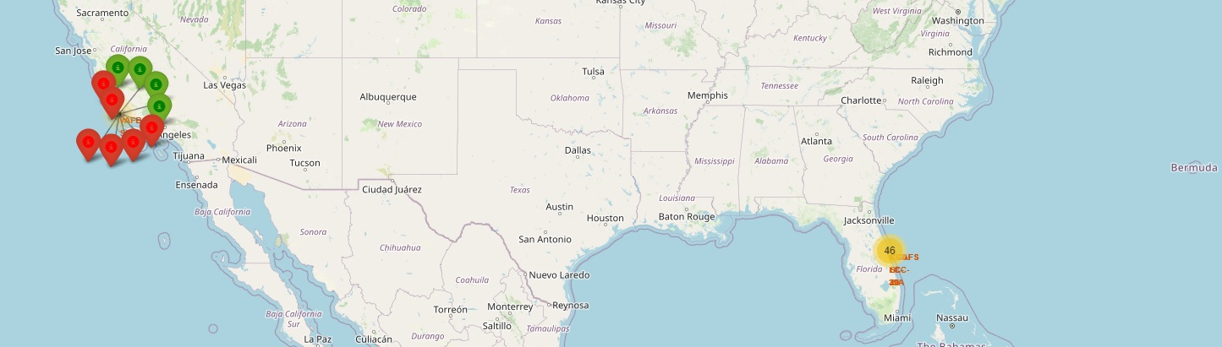
Launch Outcomes at VAFB SLC 4E
Red markers indicate failed outcomes whereas green ones indicate successful outcomes

Slide 43
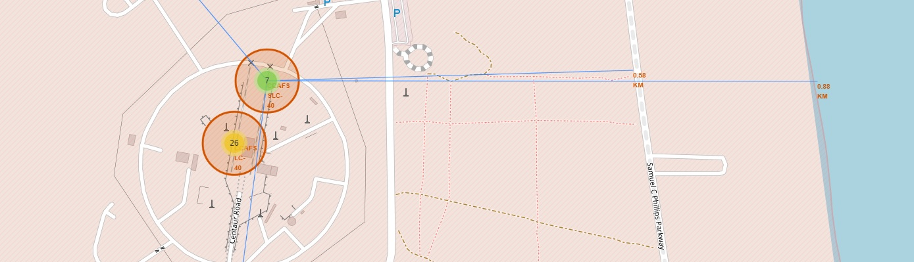
Distance of CCAFS SLC-40 from Amenities
Distance to coastline: 0.88km, melbourne: 51.43km, highway: 0.58km

Slide 44

Section 4

Slide 45
Proportion of Total Successes at each Launch Site
First position of the successes are from KSC LC-39A launch site and last position is CCAFS LC-40

Slide 46
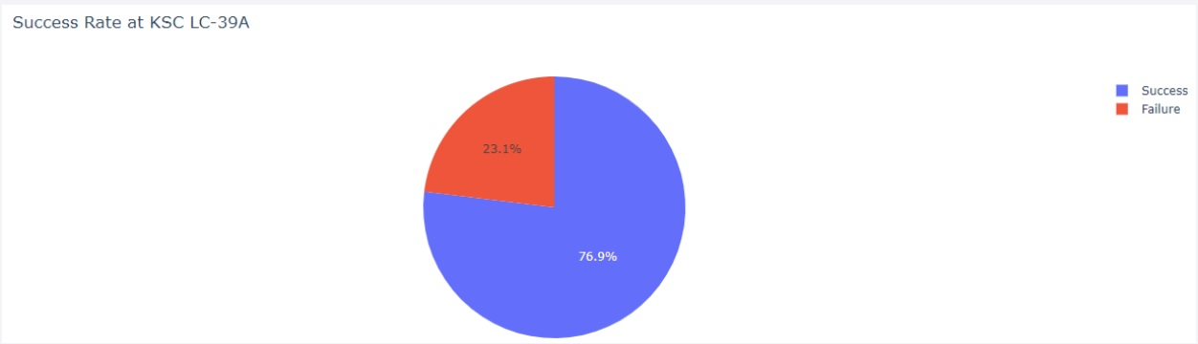
Launch Site with the Highest Proportion of Success

Slide 47
Launch Outcome versus Payload Mass for All Sites
The payload mass range is between 0 and 7 kg FT has the highest success rate and v1.1 has the lowest

Slide 48

Section 5

Slide 49
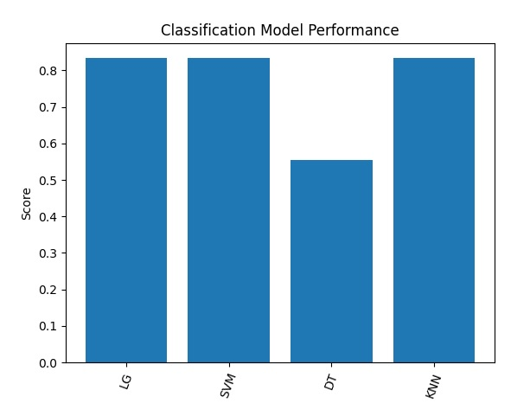
Classification Accuracy
Logistics Regression : 0.8333333333333334
Support Vector Machine : 0.8333333333333334
Decision tree method: 0.5555555555555556
K nearest neighbors : 0.8333333333333334

Slide 50
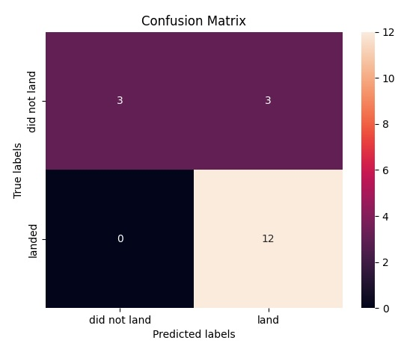
Confusion Matrix
The Logistic Regression model has no problem identifying cases where the first stage truly landed
Logistics Regression : 0.8333333333333334

Slide 51
Conclusions
The larger the flight amount at a launch site, the greater the success rate at a launch site.
KSC LC 39A is the launch site where the likelihood of first stage recovery is the highest
There are certain orbits like SSO, HEO, GEO, and ES-L1 where launches were the most successful.
It is possible to predict the fate of the first stage of Falcon 9 with a reasonably high degree of accuracy, given feature information such as launch site, payload mass, booster version, orbit type etc, using a logistic regressor
The Logistics Regression classifier is the best machine learning algorithm for this task.
As more launches take place, more data points could be added to the master data set and the regressor can be trained to be better at predicting recovery

Slide 52
Appendix
Coursera Link : https://www.coursera.org/learn/applied-data-science-capstone/home/week/5
My GitHub Link : https://github.com/yashar-javdani/Yashar-Applied-Data-Science

Slide 53


